Slide 1


FLIGHT RESERVATION SYSTEM
Submitted by :
Allen Jacob George(CSE21203)
Sameer Mansoori (CSE21254)

Slide 2

OBJECTIVE
To stores customer IDs as keys and their corresponding hashed passwords, hashed email addresses and retrieve a list of customers using hybrid data structure.
Designing an algorithm to find the shortest path between airports in a given network.

Slide 3
Overview of the hybrid data structure
The hybrid data structure being used here is a combination of hash maps (dictionaries) and a priority queue (heap).
Hash maps (dictionaries):
customer_map: This hash map stores customer IDs as keys and their corresponding hashed passwords, hashed email addresses, first names, and last names as values.
Priority Queue (Heap):
customer_list: This priority queue (implemented using the heapq module) is used to retrieve a list of customers sorted by their last names. The priority is determined based on the last name of the customer.

Slide 4
Deque :
The deque data structure is used as a queue in the BFS algorithm. It allows efficient appending and popping of elements from both ends of the queue. Here operations have a time complexity of O(1)
ensuring efficient traversal
List :
The list data structure is employed to keep track of the visited cities during the BFS traversal so that when checking if a city has already been visited, the list allows for quick verification

Slide 5
Advantages and motivations behind using this hybrid data structure
Efficient Data Retrieval: Hash maps (dictionaries) provide fast and constant-time access to customer information based on their IDs
Secure Storage of Passwords and Email Addresses: The hash functions used to store passwords and email addresses provide an additional layer of security.
Sorting and Retrieving Customers by Last Name: The priority queue (implemented using a heap) allows efficient sorting and retrieval of customers based on their last names.

Slide 6
Reduced Search Time: The breadth-first search (BFS) algorithm implemented using the hash map and queue allows for efficient searching for a path between two states (departure and arrival). By using a queue to explore neighboring states, the algorithm can find the shortest path efficiently. This is particularly important when booking flights, as it helps identify the optimal route with the minimum number of flights.
Scalability and Extensibility: The hybrid data structure used in the code can easily accommodate a growing number of customers . Additionally, the priority queue can handle sorting a large number of customers efficiently.

Slide 7
Design choices and trade-offs made during the implementation phase.
1.Hashing Passwords and Email Addresses:
Design Choice: The decision to hash passwords and email addresses using cryptographic hash functions (SHA-256 and SHA-512) was made to enhance security by protecting sensitive information.
Trade-off: Hashing passwords and email addresses adds an extra computational overhead as the hash functions are computationally expensive. However, the trade-off is justified by the increased security provided.

Slide 8
2.Use of Hybrid Data Structure:
Design Choice: The hybrid data structure combines hash maps and a priority queue to optimize various operations
Trade-off :Is justified by the improved efficiency in accessing and sorting customer information.
3.BFS for Flight Path Search:
Design Choice: The breadth-first search (BFS) algorithm is used to find the shortest path between two states (departure and arrival) when booking a flight. BFS guarantees finding the shortest path in an unweighted graph.
Trade-off: BFS provides an optimal solution in terms of finding the shortest path, but it may not be the most efficient algorithm for large graphs or graphs with weighted edges. For such cases, more sophisticated algorithms like Dijkstra's algorithm could be considered, but they come with additional complexity.

Slide 9
Practical applications of the hybrid data structure
Customer Relationship Management (CRM) Systems:
Application: CRM systems deal with a large number of customer records and require efficient data retrieval and sorting for various tasks, including customer segmentation, targeted marketing, and customer support.
Benefits: The hash map enables fast access to customer information based on their unique identifiers, such as customer ID or email address. The priority queue can sort customers based on attributes like last name or registration date, allowing for targeted actions and efficient customer analysis.

Slide 10
2.User Management Systems:
Application: The hybrid data structure can be used in user management systems where efficient storage and retrieval of user information are crucial. It can handle operations such as user login, registration, and profile management.
Benefits: Hash maps allow fast lookup of user credentials by their IDs, ensuring quick authentication. The priority queue facilitates sorting and retrieval of users based on certain criteria (e.g., last name, registration date) for administrative tasks.

Slide 11
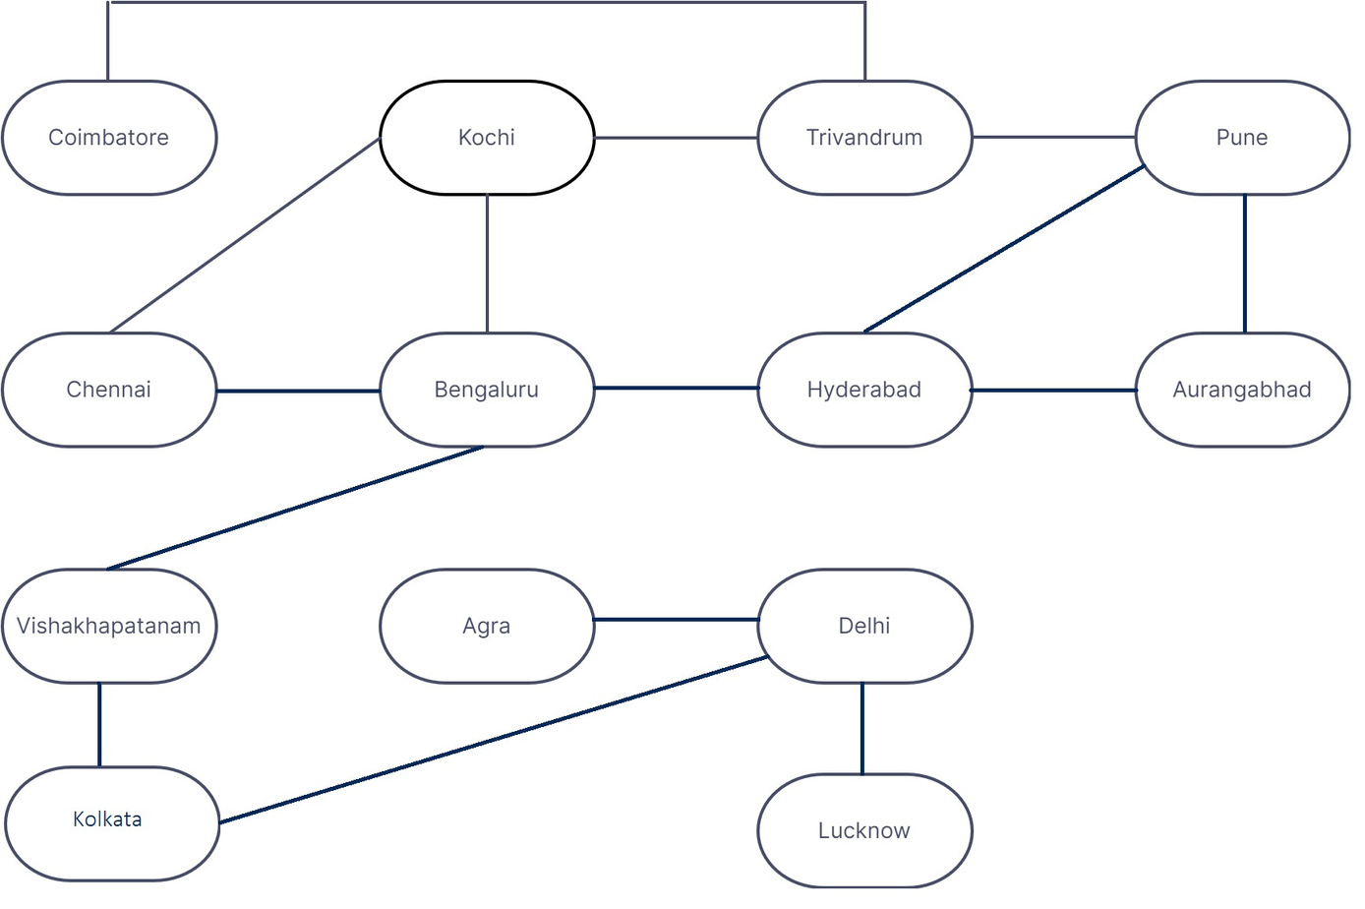
Abstract for Airport Network

Slide 12
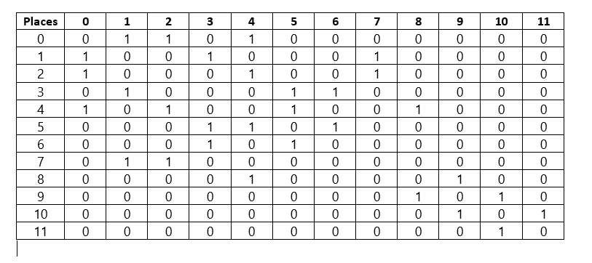
Adjacent Matrix for Airport Network
Here airports are represented in index format

Slide 13
Time Complexity Analysis:
Retrieving customer information by customer ID: O(1) (constant time) using the hash map.
Sorting customer list by last name: O(n log n) using the priority queue (heapify operation).
Checking customer credentials: O(1) (constant time) using the hash map.
Book flight (BFS): O(V + E) where V is the number of states and E is the number of edges in the state graph. In the worst case, when all states are connected to each other, it can be approximated as O(n^2), where n is the number of states.

Slide 14
Space Complexity Analysis:
The space complexity of the hybrid data structure is primarily determined by the size of the hash maps and the priority queue. It also includes the space required for storing the state graph.
Hash maps: O(N), where N is the number of customers stored in the maps.
Priority queue: O(N), where N is the number of customers stored in the priority queue.
State graph: O(1) (constant space) as the state graph is represented through conditional statements and does not grow with the input size.
Overall, the space complexity can be approximated as O(N), where N is the total number of customers

Slide 15
Performance Comparison
The hybrid data structure provides efficient performance compared to using the constituent data structures individually for the given operations.
Hash maps provide fast lookup and retrieval, which enables O(1) time complexity for operations such as checking customer/staff credentials and retrieving customer information by ID.
The priority queue enables efficient sorting of customers by last name, achieving O(n log n) time complexity for sorting.
Compared to using only a hash map or a priority queue separately, the hybrid data structure leverages the strengths of both structures, resulting in improved efficiency for the specific operations required in the airline reservation system.

Slide 16
Limitation and Improvements
Lack of Persistence: The hybrid data structure does not include mechanisms for persistent data storage. In real-world applications, it may be necessary to store data in a database or file system to ensure data persistence and reliability. Integrating a data persistence layer could be a valuable enhancement.
Limited Search Functionality: The hybrid data structure primarily focuses on fast retrieval by ID and sorting by specific attributes. However, it does not provide advanced search capabilities, such as searching customers based on specific criteria (e.g., age, location, preferences). Incorporating additional data structures or indexing techniques could improve search functionality.

Slide 17

Graph Connectivity: The current implementation of the state graph relies on conditional statements to define the connections between states. This approach can become complex and challenging to manage if the graph becomes more intricate or dynamic. Implementing a more scalable and modular graph representation could address this limitation.
Lack of Error Handling: The code does not include comprehensive error handling mechanisms. It may be beneficial to handle exceptions, input validation, and error scenarios more robustly to ensure proper functioning and user-friendly experiences.

Slide 18

Conclusion
The hybrid data structure combines hash maps and a priority queue to efficiently handle operations such as customer management, flight booking, and customer sorting.
Practical applications of the hybrid data structure include airline reservation systems, customer management systems, . It enables efficient retrieval of customer information, fast customer sorting by last name, and booking flights using a breadth-first search algorithm.

